Slide 1

Indore Bypass Road,Manglia Square Indore (M.P)

Slide 2
Web Scrapping Using Selenium
GROUP MEMBERS
Monisha Kanoje(0827IT151065)
Prachi Jain(0827IT151079)
Prachi Rathore(0827IT151080)
Shruti Shrivastava(0827IT151109)

Slide 3
Project Presentation Outline
◻Abstract
◻Introduction
◻Problem Statement
◻Project Objectives
◻Solution Proposed
◻Limitations
◻Conclusion

Slide 4
Abstract
In this system we intend to fetch the result of students from RGPV portal using selenium and store it in an excel file.

Slide 5
Introduction
Our project is all about Web Scrapping using Selenium.
Web Scrapping is a technique employed to extract large amounts of data from websites whereby the data is extracted and saved to a local file in your computer.

Slide 6
Problem Statement
To maintain the record of results of students, faculties have to enter the student’s data manually on RGPV portal and then manually store the result in an excel file. This process is repeated for every student and hence the task becomes very complex.

Slide 7
Solution Proposed
We have come up with a solution where we are doing web scrapping using selenium. Web scraper gathers website data in the same way a human would do it: the scraper goes onto a web page of the website, gets the relevant data, and move forward to the next web page. Every website has a different structure, that is why web scrapers are usually built to explore one website.

Slide 8
Objectives
The main objective of our project is –
To provide facility to faculties to view the result of all the students at one place.
To reduce manual work of faculties.

Slide 9
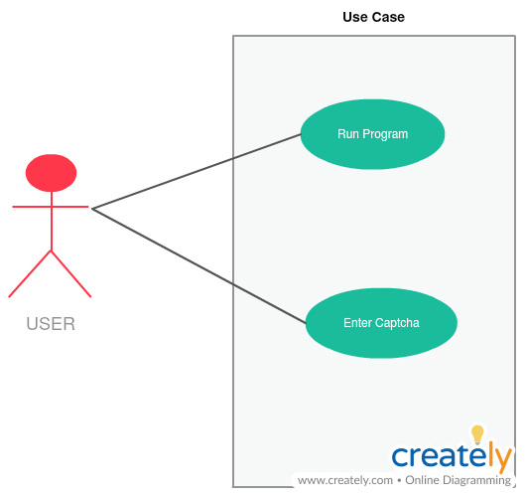
Use Case

Slide 10
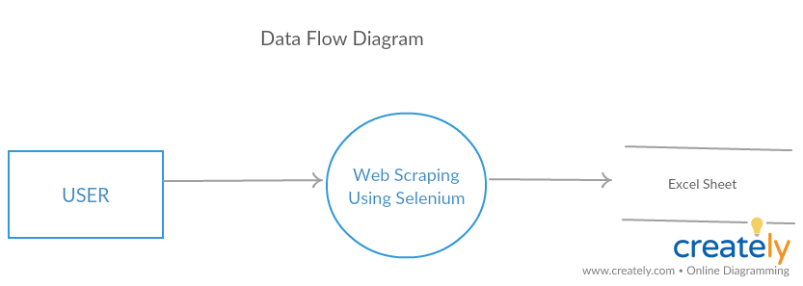
Data Flow Diagram

Slide 11
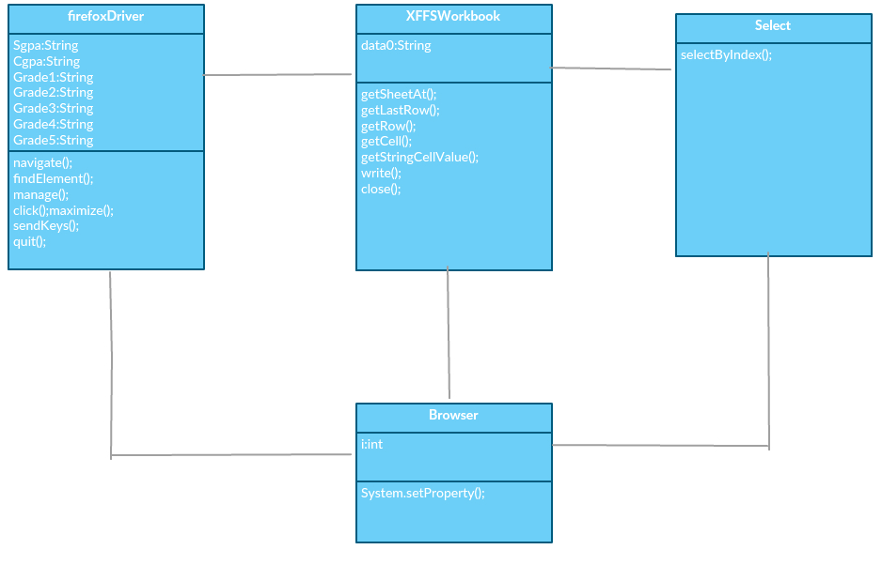
Class Diagram

Slide 12
Limitations
You have to enter captcha manually
You can only view results of current semester.

Slide 13
Conclusion
This system will extract result of students from RGPV portal by reading student’s data from excel sheet and will automatically save it in an excel file.

Slide 14
Thank-you

